Slide 1
Thermal State using DBI

Slide 2



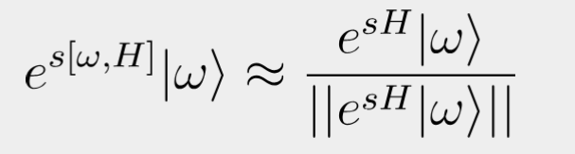
Obtaining thermal state from imaginary evol
Applying imaginary time-evolution to thermofield double state and purifying gets us thermal state
Getting the state at infinite temperature is easy (just the maximally entangled state)
What happens if we use DBI (and its approximations) instead of the imaginary time evolution

Slide 3


How to choose scheduling?
Exact solution that minimizes the energy and fidelity
Approximation of minimizing the free energy
Exact solution that approximates polynomial expansion

Slide 4
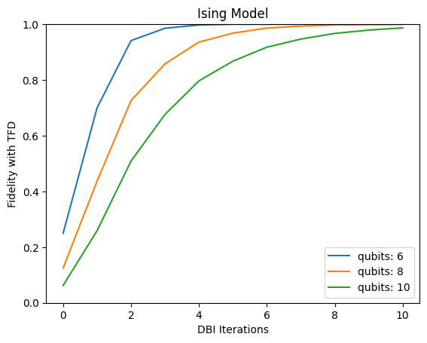
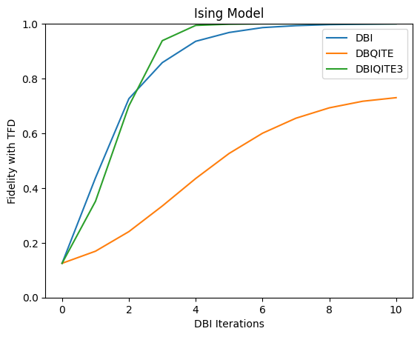
Energy scheduling
The fidelity is computed with respect to the ground state. Fast convergence but problems with the most straight forward approximation.

Slide 5
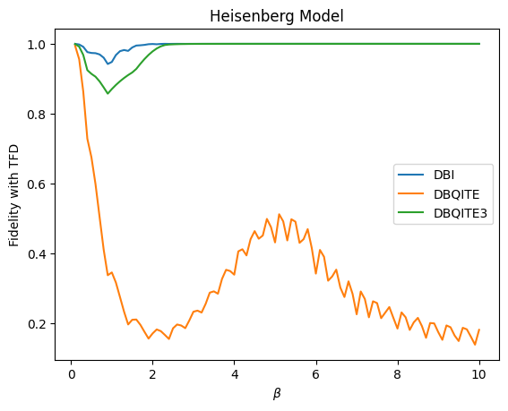
Energy Scheduling
While nice for ground state preparation, it fails to accurately converge to the thermal state at low temperatures.

Slide 6
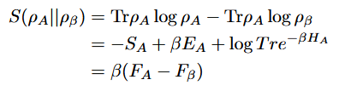


Free Energy
The relative entropy between the purification and the Gibbs state can be related to the free energy: minimizing one minimizes the other
One can get a more explicit equation if the state is obtained from the DBI

Slide 7
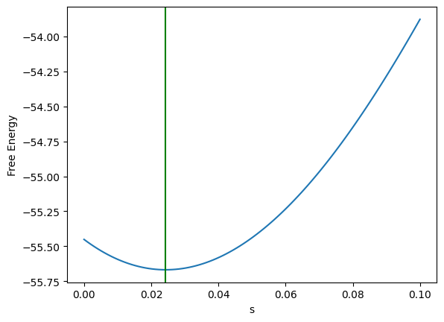
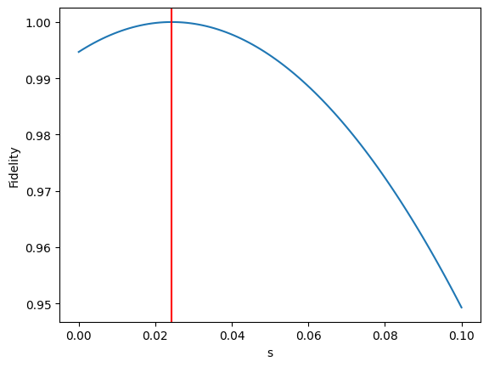
Free Energy
Minimum of free energy implies maximum of fidelity

Slide 8


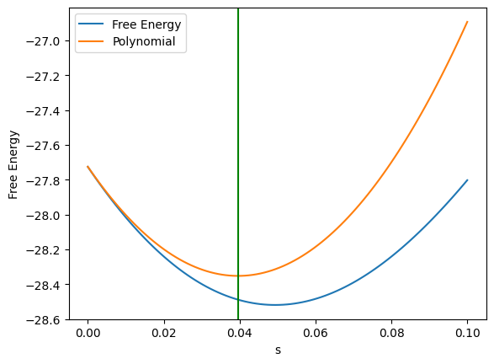
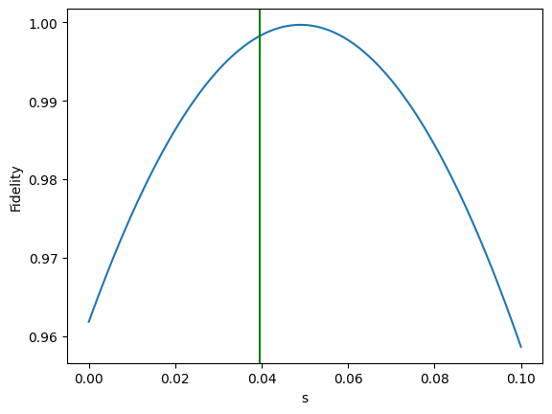
Free energy
No analytic expression for the free energy minimizer could be found
We use instead a polynomial approximation

Slide 9
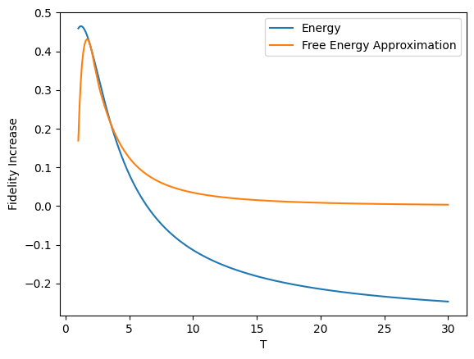
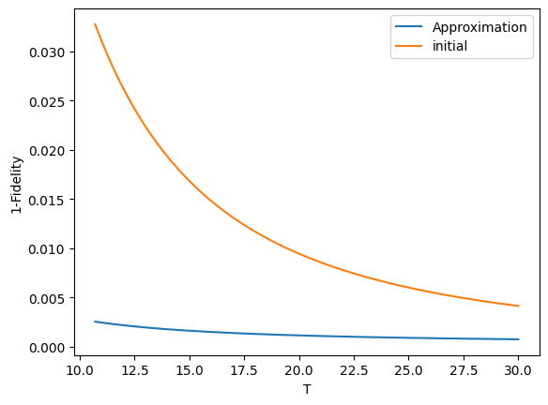
Free energy using polynomial approximation
Improves the fidelity in the high temperature regime. Totally fails in the cold regime. There is still a part where both scheduling fail.

Slide 10

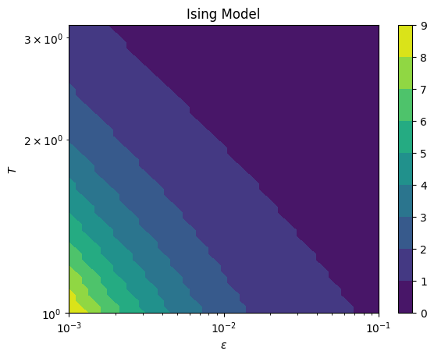

Truncated imaginary time evolution
can be
approximated exactly
Apply k DBIs such that is done
exactly and this approximates
the exponential

Slide 11

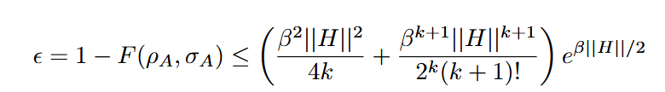

Error upper bound
The truncation error can be upper bounded
This implies an error on the fidelity
If the Hamiltonian norm grows with the system size, we have

Slide 12
Conclusions + Outlooks
Using the free energy should be the best approach but finding the exact scheduling is hard.
The truncation is the best alternative but the error scales exponentially while decreasing linearly with number of iterations
Initial comparison between these two methods suggests truncation behaves in a similar manner to the free energy
Truncation uses naïve approach, if one instead approximates the Taylor series the error decreases as a factorial
Problems with DBQITE. Finding scheduling for it is harder. We tried finding the error if we use a polynomial truncation but it is also hard without asuming more on the function. Might need to use DBQITE3 to reutilize the previous scheduling.

